Slide 1
BUILDING INNOVATIVE TECHNOLOGY

Slide 2
NEVER
LET
CODE
DEFEAT
YOU

Slide 3




Admin@bit.co.za
+27 41 992 9990
Building 101,
00 Caledon Street,
UTH, 6229
bit1ims.club
Inventory Management System
Multi User mode
Multi Access Levels
Serial input
Inventory Tracking
Built-in reports
Dashboards
Quick search
Multi Platform
QR Code
Location Support
Secure Web Access

Slide 4

Admin@bit.co.za
+27 41 992 9990
Building 101,
00 Caledon Street,
UTH, 6229
bit1ims.club
Neerav Panchal
(Software Developer)
Mauritz Langeveld
(Software Developer)

Slide 5

NEVER
LET
CODE
DEFEAT
YOU

Slide 6
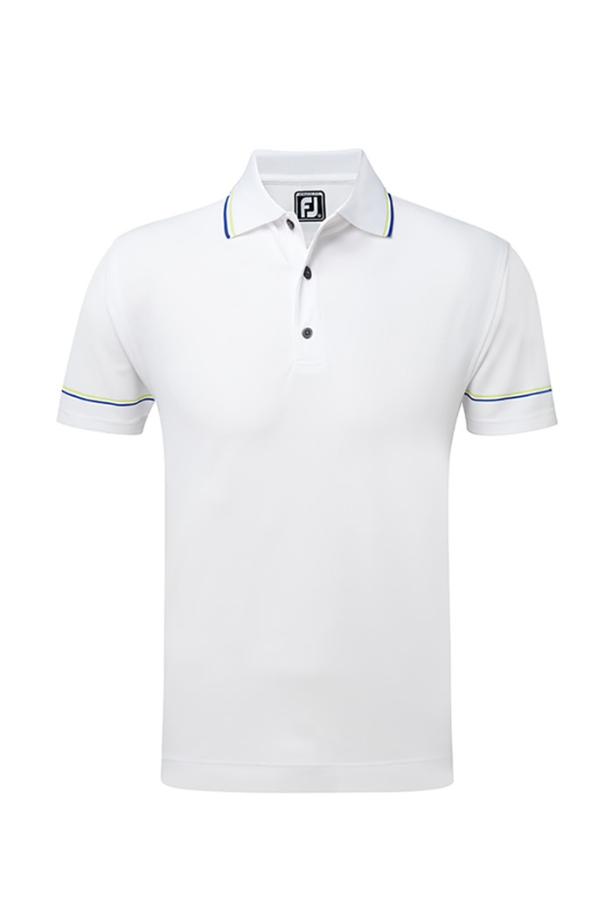
NEVER
LET
CODE
DEFEAT
YOU

Slide 7
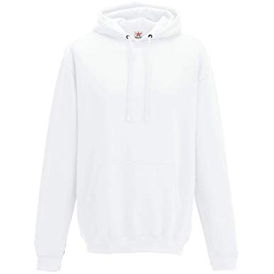

Slide 8


